Slide 1
3d vocabulary

Slide 2
Torus cylinder sphere cube
Cube = 3d square
Sphere = 3d circle
Cylinder = can shape
Torus = donut shape

Slide 3
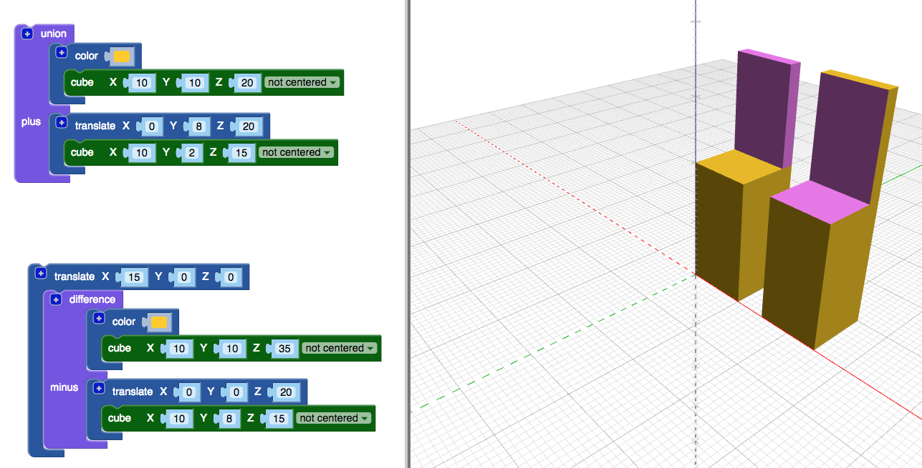
Additive and subtractive modeling
Additive
Join parts together
Subtractive
Cut one part away from another

Slide 4
Scale - translate - rotate
Scale = change size
Translate = change position
Rotate = turn

Slide 5
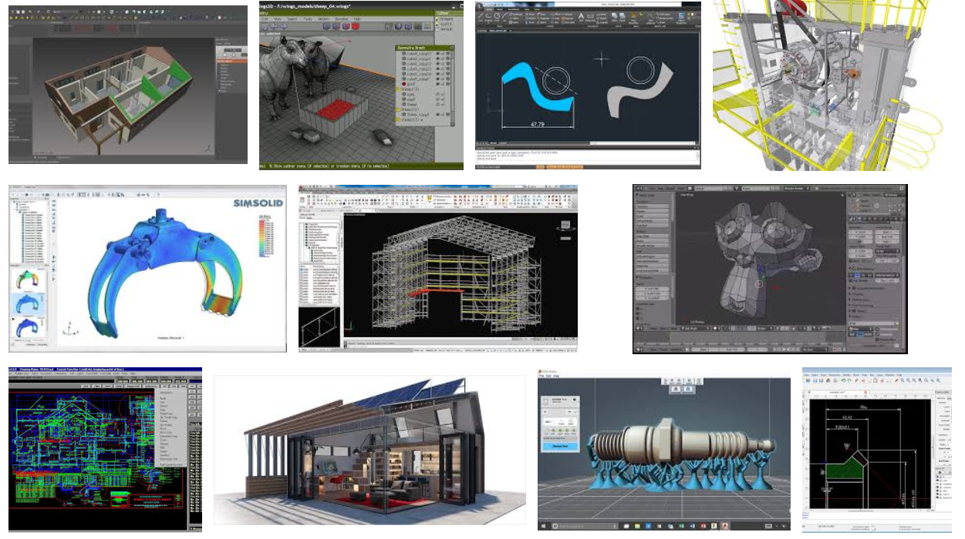
CAD CNC
CAD = Computer aided design = TinkerCad, blocksCAD
CNC = Computer Numeric Control = cutting machine by computer control

Slide 6
STL
File format for 3D design files

Slide 7
manufacture
Make a large quantity of items using a process

Slide 8
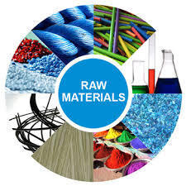
Raw material
Unprocessed items used in production
What something is made from.

Slide 9
prototype
Small scale model

Slide 10
Assembly line
An organized, repeated process by robots or people to manufacture items

Slide 11
QC
Quality control
Be sure items that are manufactured meet the standards

Slide 12
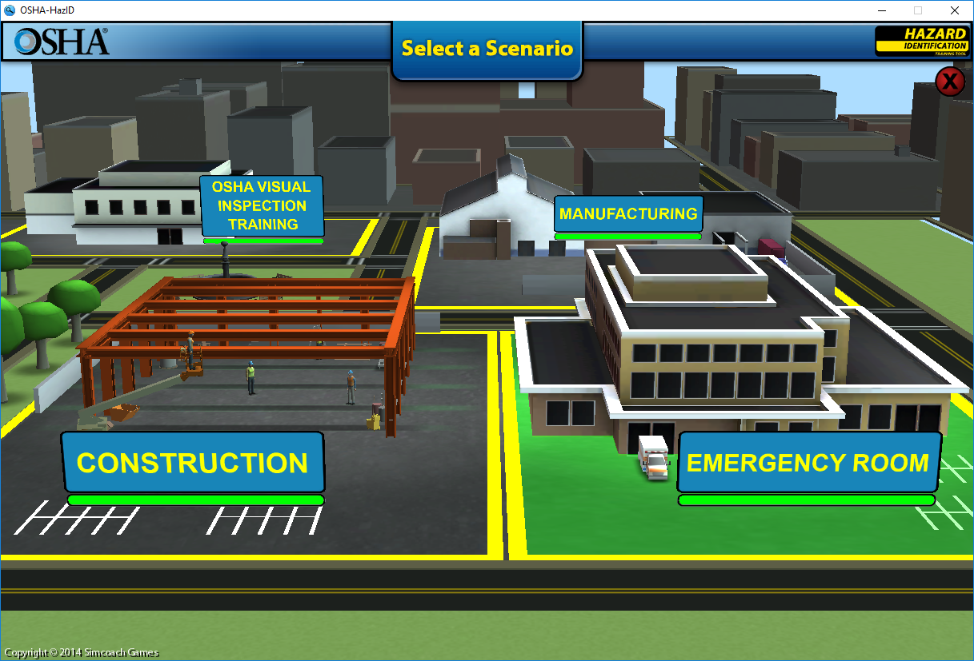
OSHA
Organization to be sure safety rules are followed.

